Slide 1


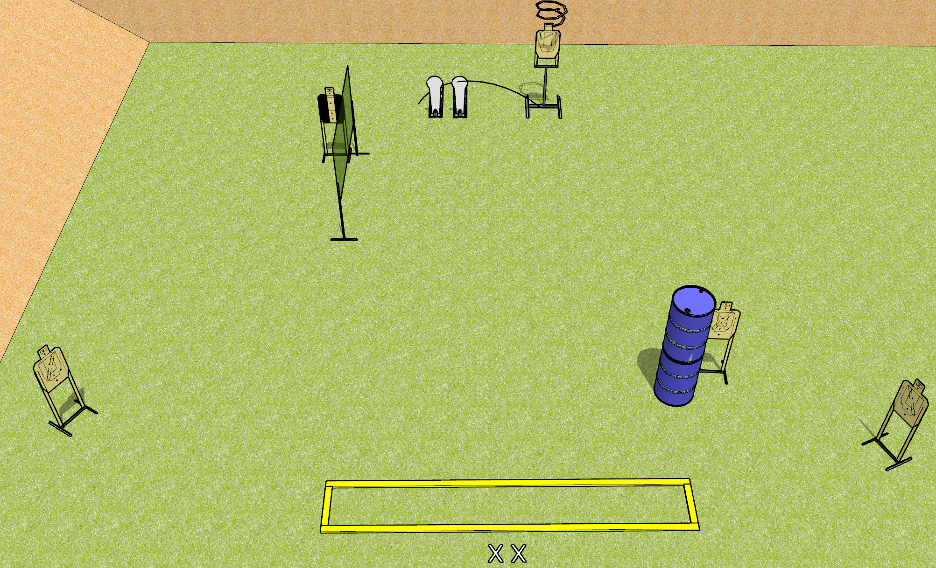
 | Dothan Gun Club – USPSA Match Measuring Yourself Again Course Designer : Drew Coleman
START POSITION : Standing with both feet on X’s, wrists below belt
GUN READY CONDITION : Pistol loaded and holstered. PCC loaded, held with both hands, shouldered, safety on, pointed at orange cone. |  | SCORING: Comstock, 12 rounds TARGETS: 5 paper, 2 Steel SCORED HITS: Best 2 on paper, steel until down START-STOP: Audible, last shot RULES: Drop turner is disppearing
STAGE PROCEDURE: Engage targets as they become available from within the fault lines.

Slide 2
Measuring Yourself Again
Written Stage Briefing
Measuring Yourself Again is a 12 round, 60 point, Comstock short course. There are five USPSA targets and two colt poppers. The best two hits on paper will score, and steel must fall to score. The start signal is audible.
Either colt popper will activate the drop turner. The drop turner is a disappearing target. Please check the activator and set it the same way every time.
Handgun start position is standing with both feet on X’s, wrists below belt. Handgun is loaded and holstered.
PCC start position is standing with both feet on X’s, muzzle pointed at orange cone. Loaded carbine is held with both hands, shouldered, safety on.
On start signal, engage targets as they become available from within the shooting area.

